Slide 1

Counterfactuals Explanations and Imputation Models
Rebecca Knowlton
3/28/2022

Slide 2
Agenda
Counterfactual Explanations Without Opening the Black Box: Automated Decisions and the GDPR (Wachter, Mittelstadt & Russell, 2018)
Multiple Imputation
Counterfactuals as a Diagnostic Tool

Slide 3
Motivation for Counterfactual Explanations
Complex models increasingly used for high-stake decisions
Want explainability for “black box” models to build trust
Three goals for providing explanations to data subjects:
Help subject understand why decision was reached
Provide grounds to contest adverse decisions
Understand what could be changed to achieve desirable outcome in the future

Slide 4
What is a Counterfactual Explanation?
“You were denied a loan because your annual income was $50,000. If your income had been $75,000, you would have been offered a loan.”
Multiple counterfactuals are possible, but goal is to find “closest possible world” with the desirable outcome
Since goal is to aid human understanding, preference for sparse and relevant counterfactuals (i.e. variables that are mutable or have real world probability of change)
Should provide minimal information capable of altering a decision
Doesn’t require data subject to understand the internal logic of the model in order to use it

Slide 5


Generating Counterfactuals
Many standard classifiers of ML are trained by finding optimal set of weights w that minimizes an objective over a set of training data:
Want to find a counterfactual x’ as close to the original x as possible such that f_{w}(x’) is equal to a new target y’. Hold w fixed and minimize the related objective:
Where d(∙,∙) is a distance function that measures how far the counterfactual x’ and the original data point x are from each other
In practice, maximization over λ is done by iteratively solving for x’ and increasing λ until a sufficiently close solution is found

Slide 6

Choosing a Distance Function
Choice of distance function is important since it determines which x’ will be closest to the original x
Sensible first choice is the L₁ norm weighted by the inverse median absolute deviation, MAD_{k} for feature k:
This distance metric has several desirable properties:
Captures intrinsic volatility of the space (if feature k varies wildly across dataset, x’ may also vary this feature while remaining “close” to x)
MAD is more robust to outliers than standard deviation
L₁ norm has sparsity-inducing properties

Slide 7
Example: Pima Diabetes Dataset
Predict risk of diabetes for women of Pima heritage
Three-layer fully-connected neural-network with two hidden layers of 20 neurons to perform logistic regression
8 input variables (number of pregnancies, age, BMI, etc)
Generate counterfactuals: “what would have to be different for the individual to have a risk score of 0.5?”
Use L₁ norm weighted by inverse median absolute deviation, to induce sparsity
Cap variables to prevent them from going outside the range seen in training data

Slide 8
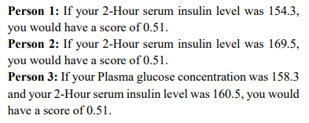
Example: Pima Diabetes Dataset

Slide 9
Advantages of Counterfactual Explanations
Bypass the challenge of explaining internal workings of a complex model
Don’t have to “open the black box”
Provide information to data subject that is easily digestible and practically useful
Regulatory benefits: more straightforward than other methods for satisfying the EU General Data Protection Regulation (GDPR) “right to explanation”

Slide 10
Switching Gears… Multiple Imputation
Multiple imputation (MI) = method for dealing with missing data.
Two stages:
A data disseminator creates small number of completed datasets by filling in the missing values with samples from an imputation model
Analysts compute their estimates in each completed dataset and combine them into pooled estimates and standard errors (incorporates the additional variability due to the missing data)

Slide 11

Notation
Let Y_{i} = (Y_{i1}, Y_{i2}, …, Y_{ip}) denote a p-dimensional vector of values corresponding to the ith unit, and R_{i} = (R_{i1}, R_{i2}, …, R_{ip}) be a vector of indicator variables representing the response pattern
R_{ij} = 1 if Y_{ij} is observed, 0 otherwise
Use lowercase letters to distinguish fixed values from random variables, and denote realized values in a particular dataset with a tilde, e.g.
$R_{i}=$ random vector
$r_{i}=$particular value taken by $R_{i}$
$\tilde{r_{i}}=$observed response pattern for unit i in a particular dataset
Let $R=\{R_{i}:1 ≤i ≤n\}$ with $r$ and $\tilde{r}$ defined similarly
The observed and missing values from a dataset of size n with response pattern R are denoted Y_{obs}(R) and Y_{mis}(R)

Slide 12
Missing at Random Assumption
In MI settings, we typically assume the missing data are missing at random (MAR), that is,
takes the same value for all y_{mis} and ϕ, where ϕ parameterizes our model of the response mechanism [the distribution of (R | Y)]
In words, MAR means the probability a variable is missing depends only on available information
E.g. if sex, race, education, and age are recorded for people in a survey, then “earnings” is missing at random if the probability of nonresponse to this questions depends only on the other fully recorded variables
Under MAR, we don’t need to explicitly model the response process to impute the missing data
A simpler assumption is when data are missing completely at random: the probability of missingness is the same for all units (e.g. missing with p = 0.3)

Slide 13
Multiple Imputation Diagnostics
Extensive methodology for generating imputed datasets, but diagnostics for imputation models are limited
Challenge of diagnostics: you don’t know what analyst will do with your data
One idea: posterior predictive checks (He & Zaslavsky, 2012)

Slide 14
Posterior Predictive Checks
MI fills in missing data with posterior predictive draws from an imputation model
To evaluate the imputation model, can compare completed data with their replicates simulated under the imputation model

Slide 15
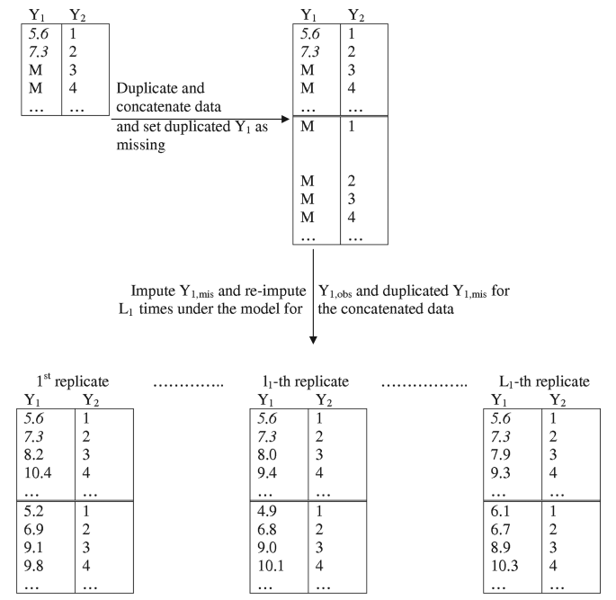
Posterior Predictive Checks
For estimand of interest Q (e.g. means, regression coefficients, quantiles, etc), find proportion where Q is bigger for the completely duplicated data than the original

Slide 16
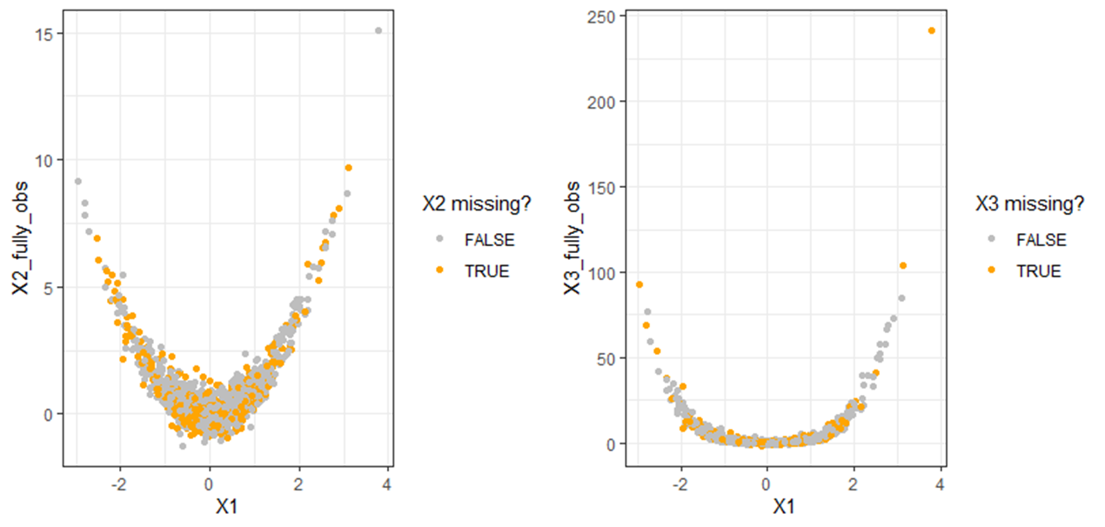
Synthetic Data Example
X1 fully observed, X2 and X3 are missing completely at random (Bernoulli, p = 0.3)
n = 1000
Quadratic DGP, linear imputation

Slide 17
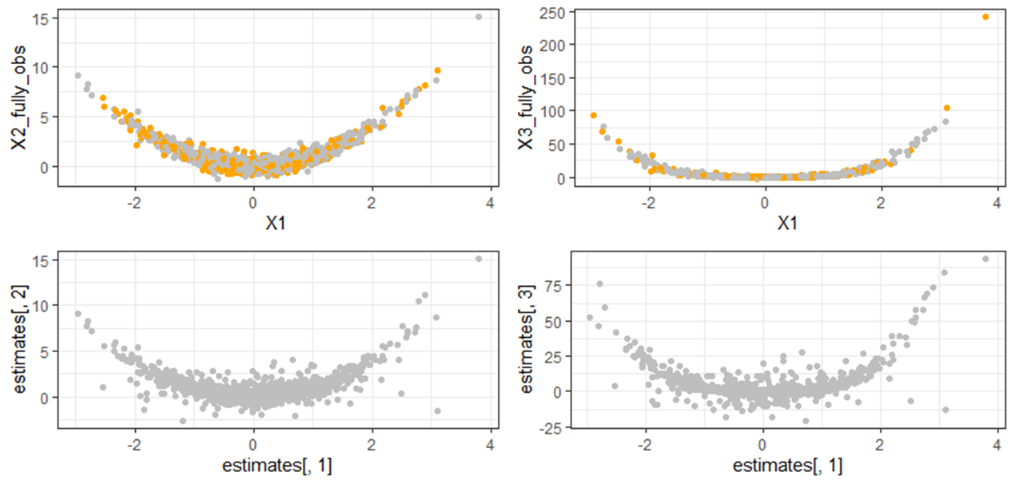
Imputed Dataset

Slide 18
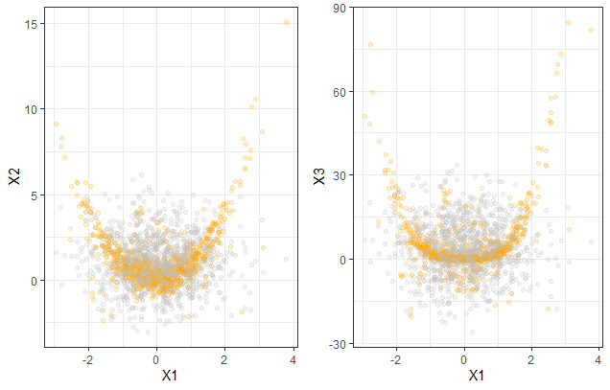
Posterior Predictive Checks for Regression Coefficients
Duplicate and concatenate data with 100% missingness for X2 and X3 (n = 2000)
Generate m = 100 imputed datasets
For each imputed dataset, fit regression on original data (first 1000 rows) and duplicated data. How often are the coefficients bigger for the duplicated data?
Orange = original,
Gray = duplicated

Slide 19
Posterior Predictive Checks for Regression Coefficients
X2 regressed on X1
Intercept: p = 0.55
X1 coefficient: p = 0.75
X3 regressed on X1 + X2
Intercept: p = 0.52
X1 coefficient: p = 0.56
X2 coefficient: p = 0.53
These don’t seem that bad…

Slide 20
Posterior Predictive Checks for Regression Coefficients
But what about quadratic terms?
X2 ~ X1^2 has p = 0, 1
X3 ~ X1^2 + X2^2 has p = 0.66, 1, 0
Just looking at linear regressions didn’t make the imputation model look bad, but it’s totally inadequate for the quadratic relationship

Slide 21
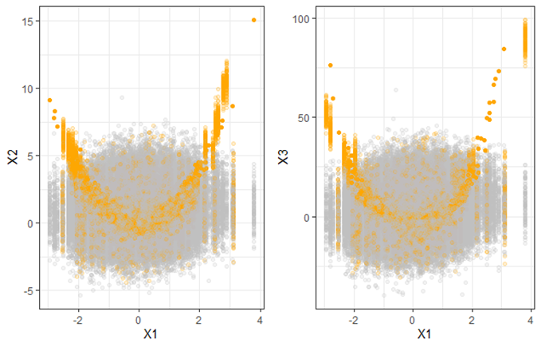
Classifiers as a Diagnostic Tool
If we can train a classifier to predict which data were original vs duplicated, that can tell us where the imputation model is failing (doesn’t rely on which estimands we choose to look at)
From the posterior predictive checks, we have 200,000 rows of data (half “original” and half “duplicated”)

Slide 22
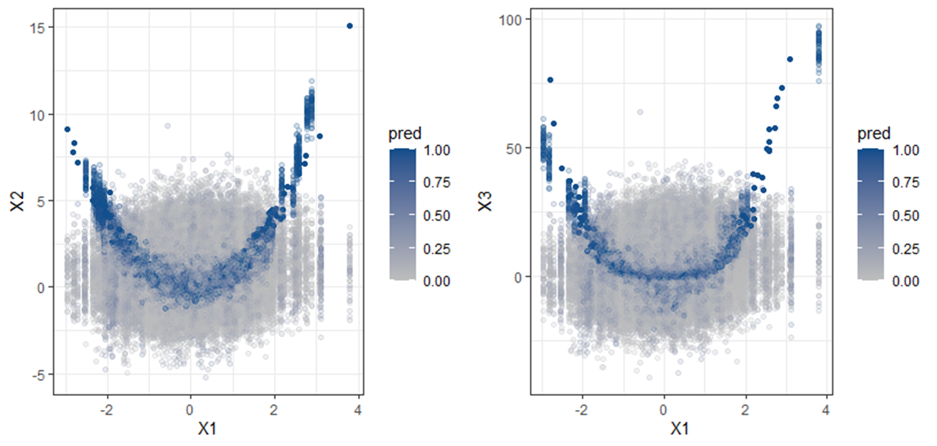
Fit Random Forest
Random forest with 100,000 rows of training data, 100,000 rows of testing data
Predict likelihood a datapoint was in an original (not duplicated) set

Slide 23
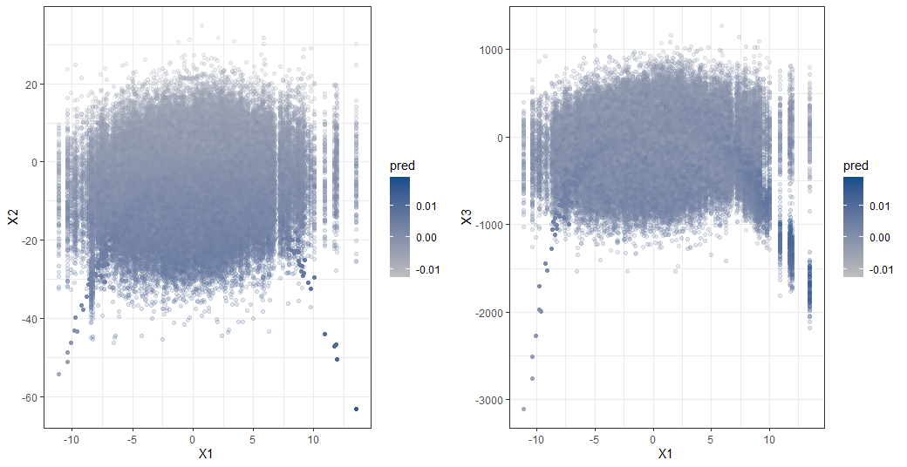
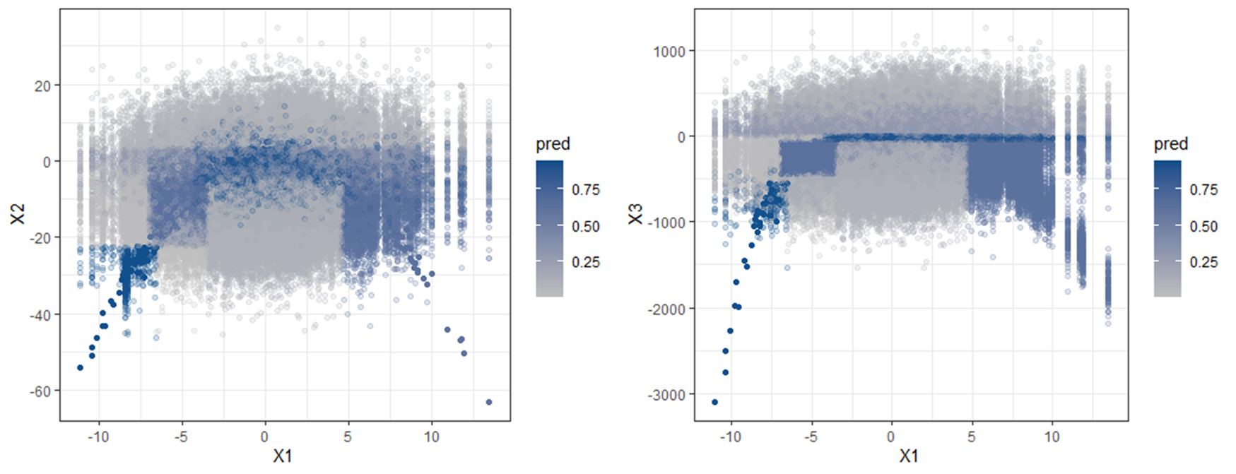
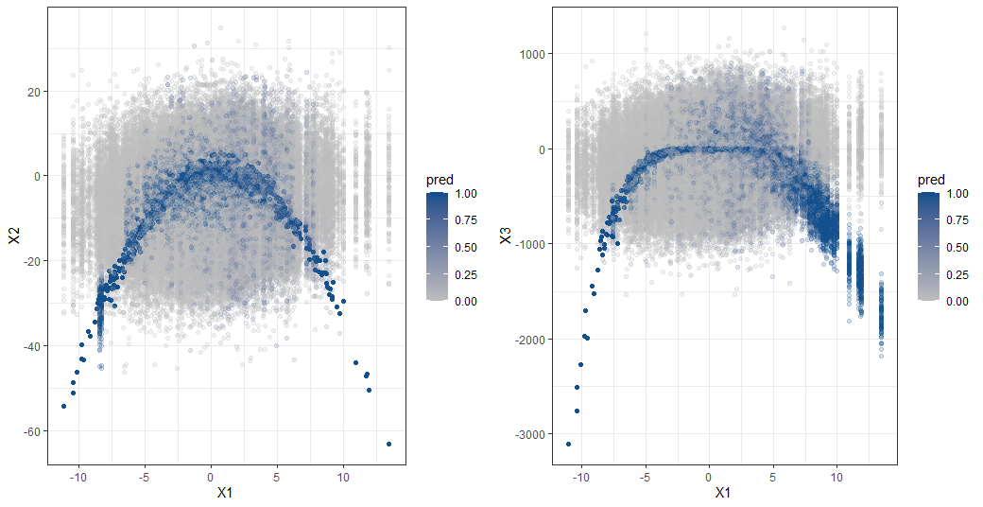
Next Step: Incorporating Counterfactuals
Logistic Regression
Flexible models like a random forest provide better insights where imputation model is failing
Need to explain to human imputer the factors affecting classification
Counterfactuals as an idea generator for updating imputation model
CART
Random Forest

Slide 24
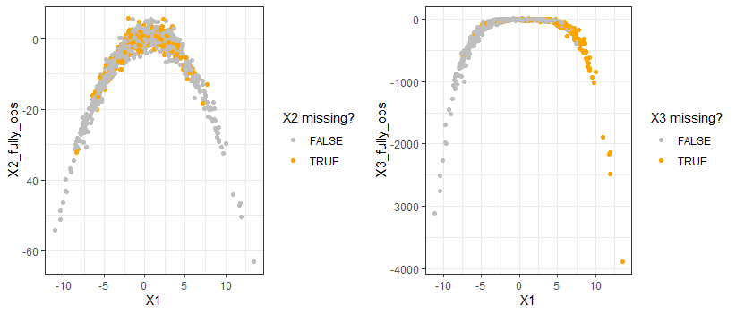
Separating shortcomings of imputation model from the missingness pattern
Sometimes classifier can predict original vs duplicated accurately due to the pattern of missingness, not the imputed value
Want to focus in on where the important feature for prediction is the imputed value itself, not pattern of missingness given other variables
One idea… how does predicting R_{i} given X_{(-i)} differ from predicting R_{i} given X_{i}, X_{(-i)}

